Slide 1
TIME SERIES ANALYSIS
CHICAGO CRIME DATASET
Max Jacobs Mayukh Sen
Krish Shah
Manan Jagani
Divya Shah

Slide 2
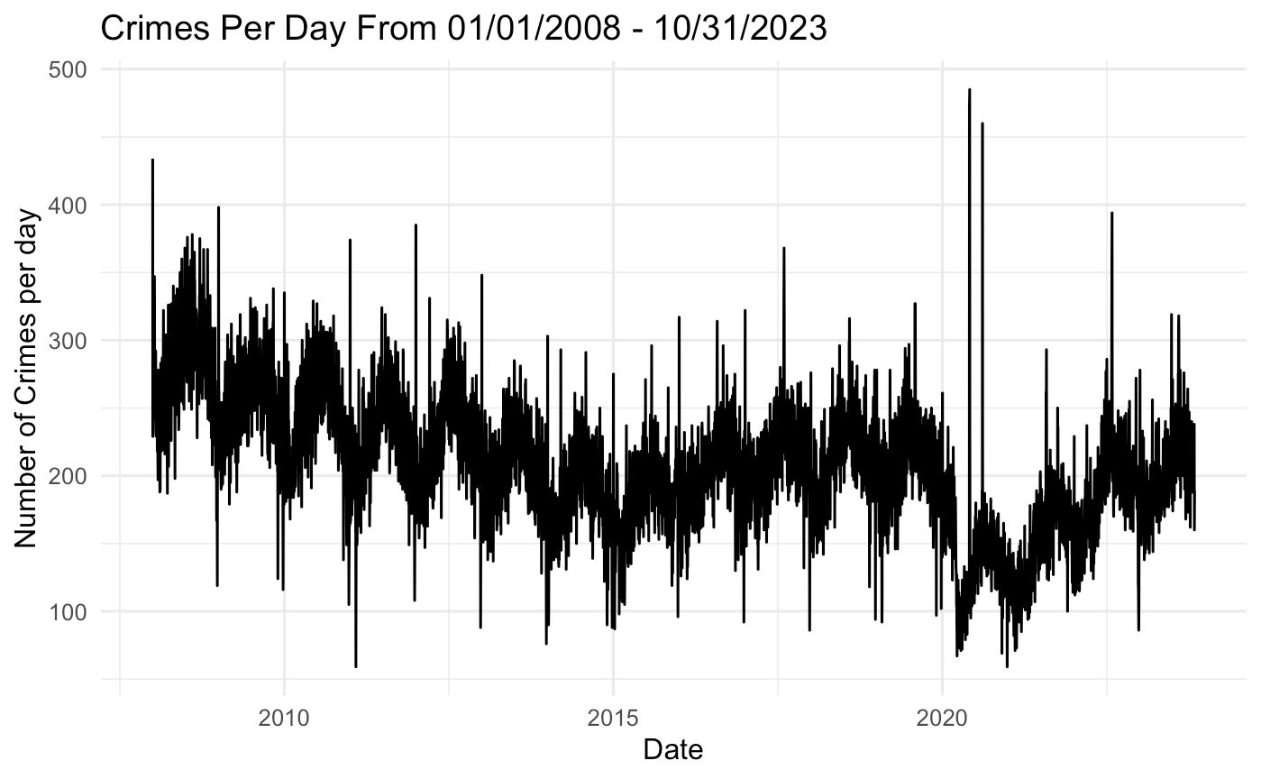
OBJECTIVE
Perform a thorough Time Series analysis and forecast crime rates by employing a variety of models to ensure accurate and reliable predictions.
Gain insights into the temporal patterns of crime, understand the impact of different factors on crime occurrence.

Slide 3
DATASET DESCRIPTION
Extracted from Chicago Data Portal, and filtered from January 1, 2008 to October 31, 2023
Consists about ~4.6M rows with 22 features.
Important Attributes:
Date-time | Year | Case Number
Crime Type | Location Type | Ward
District | Arrest | Domestic
X - coordinate | Y - coordinate | Block Address

Slide 4
METHODOLOGY
DATA PRE-PROCESSING
05
FORECASTING
01
04
MODELING
EXPLORATORY DATA ANALYSIS
02
03
SPATIAL ANALYSIS

Slide 5
DATA PRE-PROCESSING
Removed Null and Duplicate Values.
Dropped unnecessary columns.
Encoded Categorical Columns ( Arrest and Domestic) to Numeric values
Converted the date column to a standardized date-time format and extracted additional features, including Month, Day of the Week, and Hour
Grouped the 35 types of crime into 12 categories based on US Crime Topology.

Slide 6
EXPLORATORY DATA ANALYSIS

Slide 7
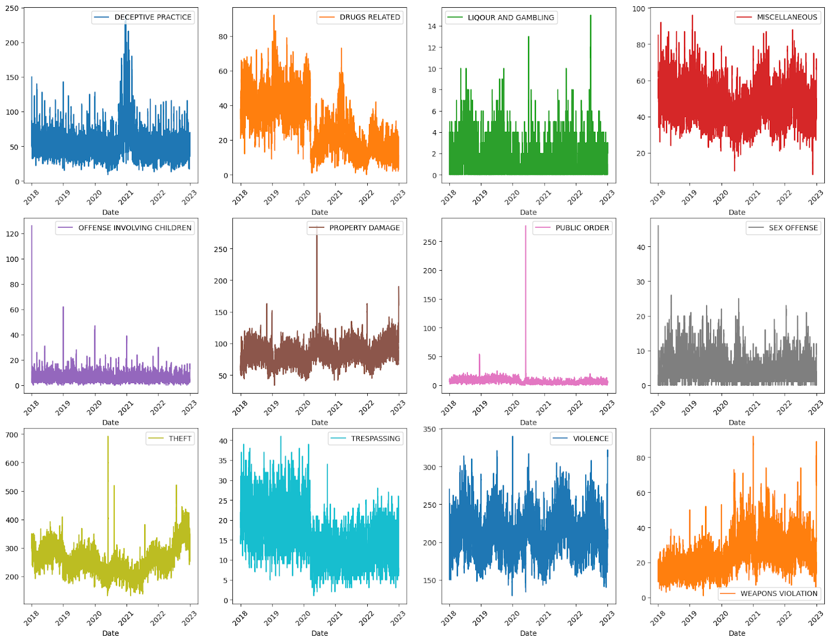

Slide 8
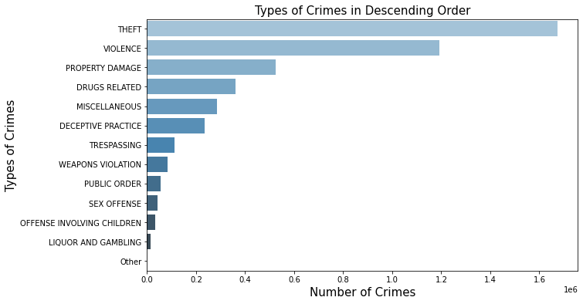

Slide 9
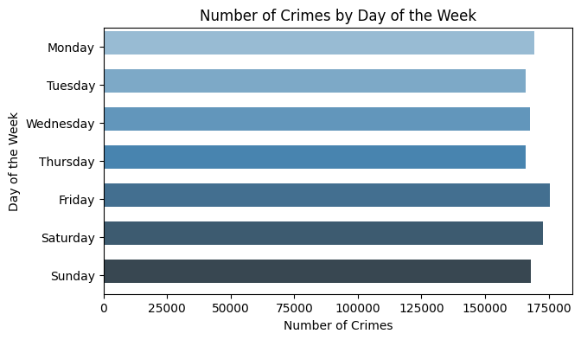
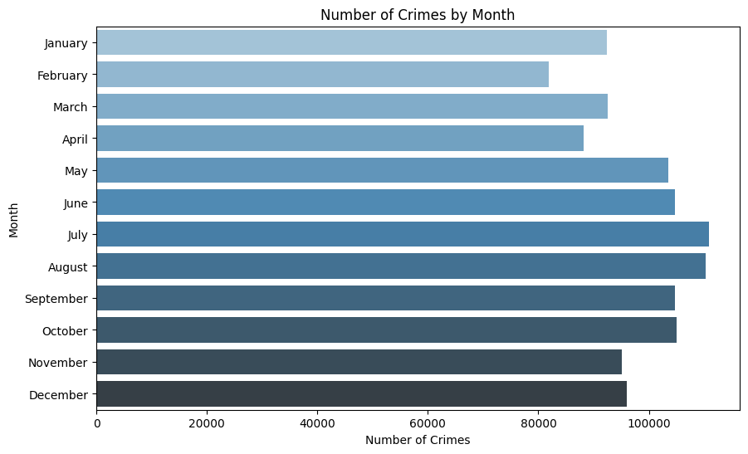
CRIME RATE W.R.T DAY AND MONTH

Slide 10
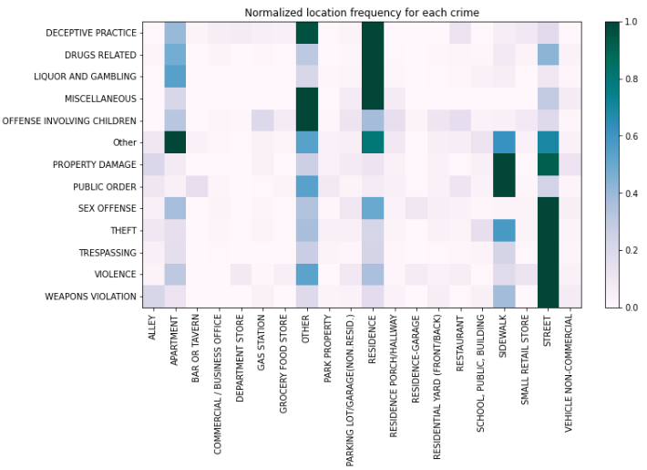

Slide 11
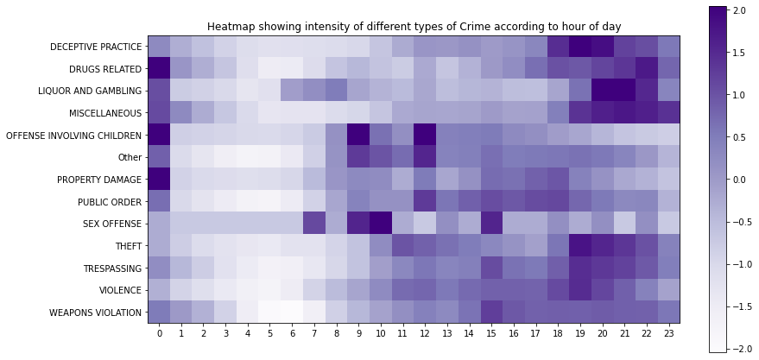

Slide 12
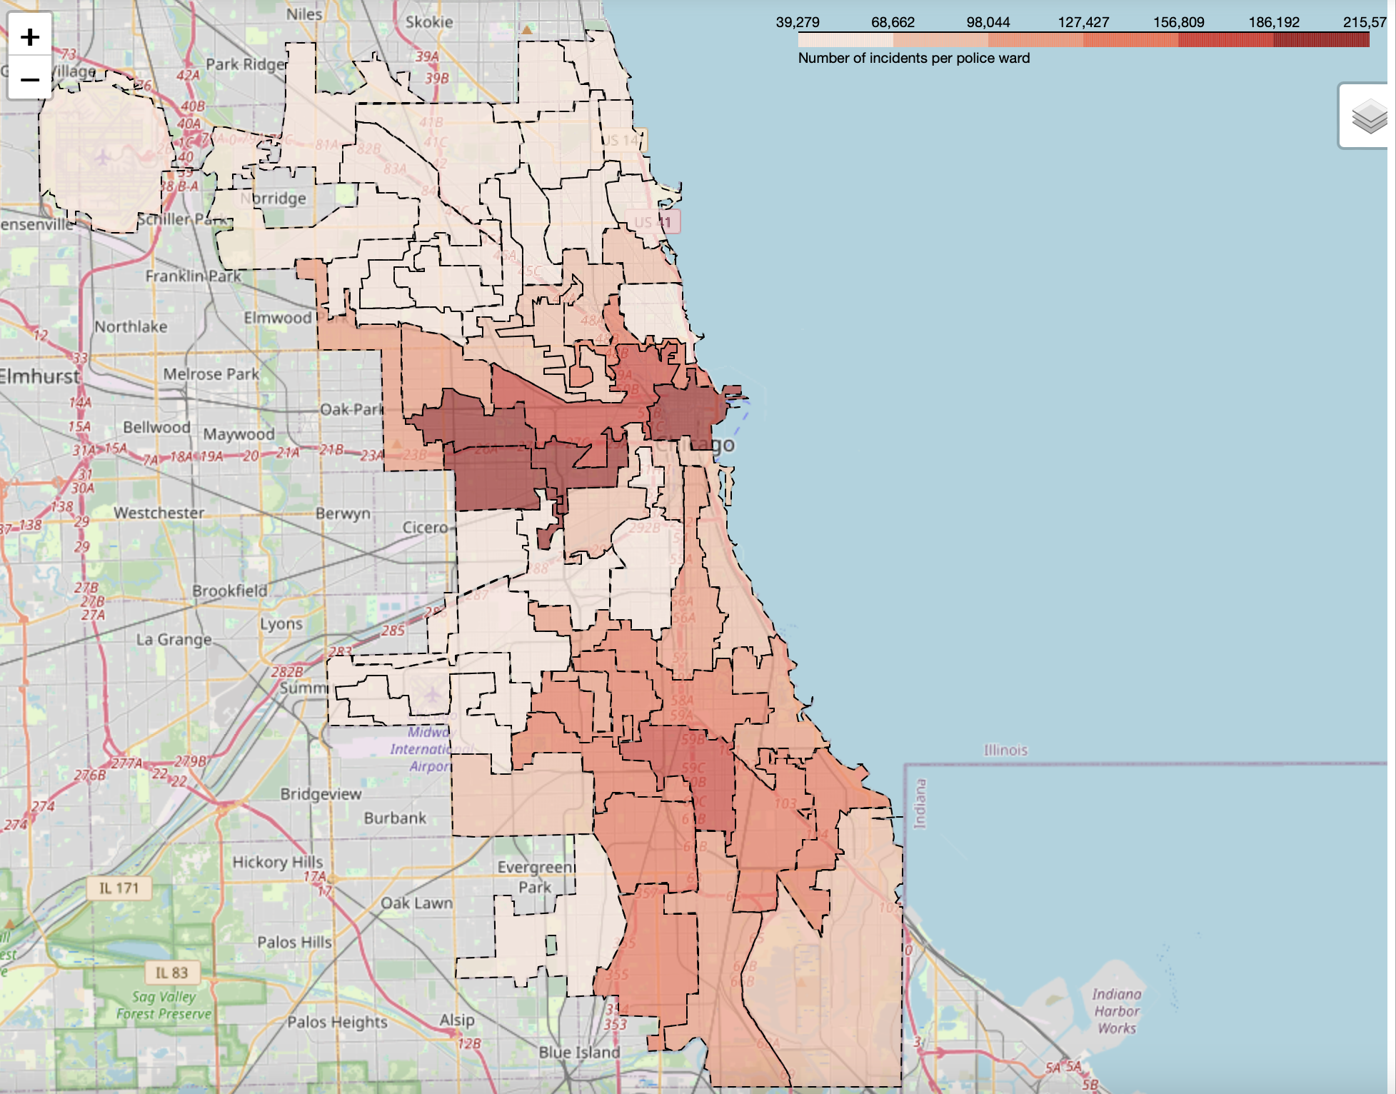
SPATIAL ANALYSIS
Wards 24,27,28, 42 exhibited the highest crime rates.
These wards cover downtown Chicago.

Slide 13
TiME SERIES ANALYSIS
Decomposition of Time Series
ACF, PACF plots
Test for stationarity

Slide 14
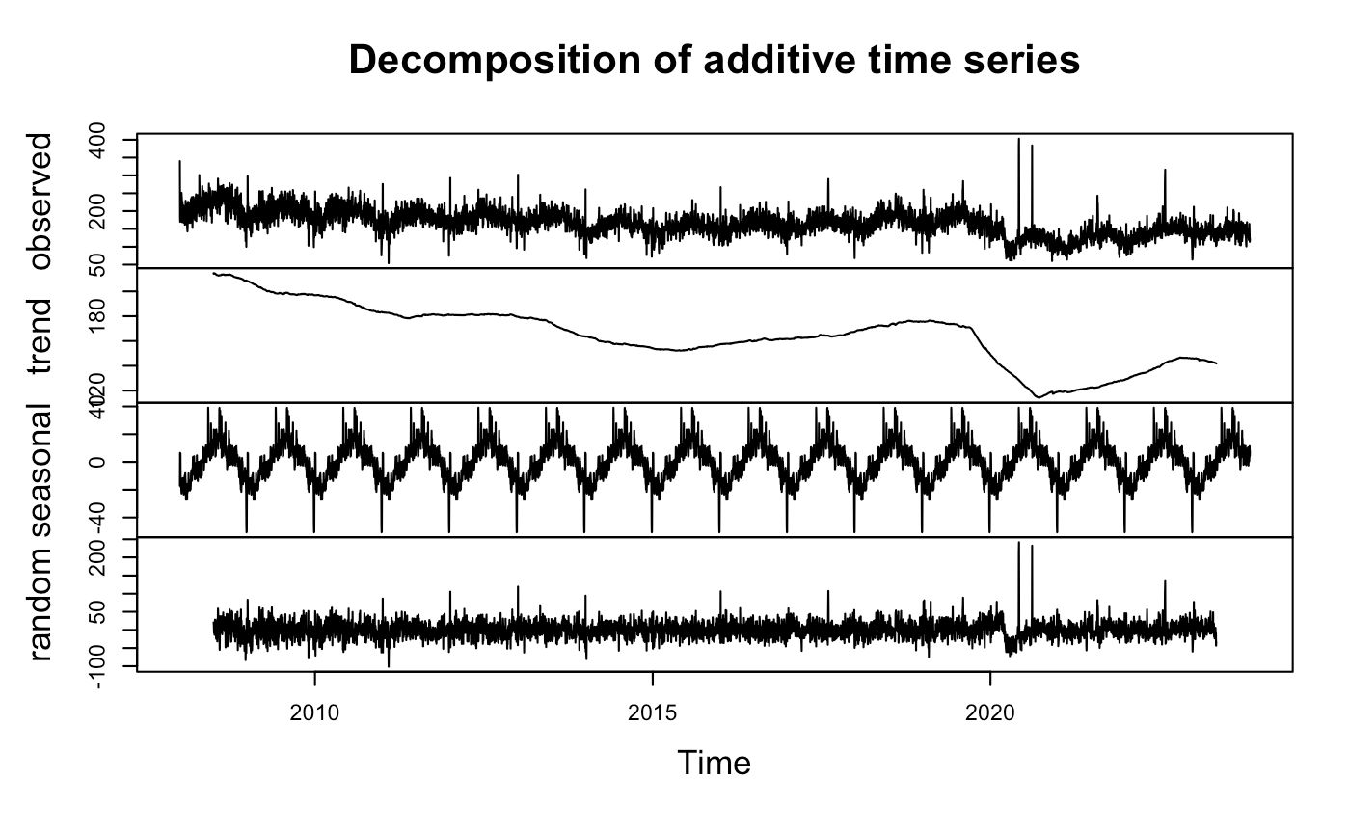

Slide 15
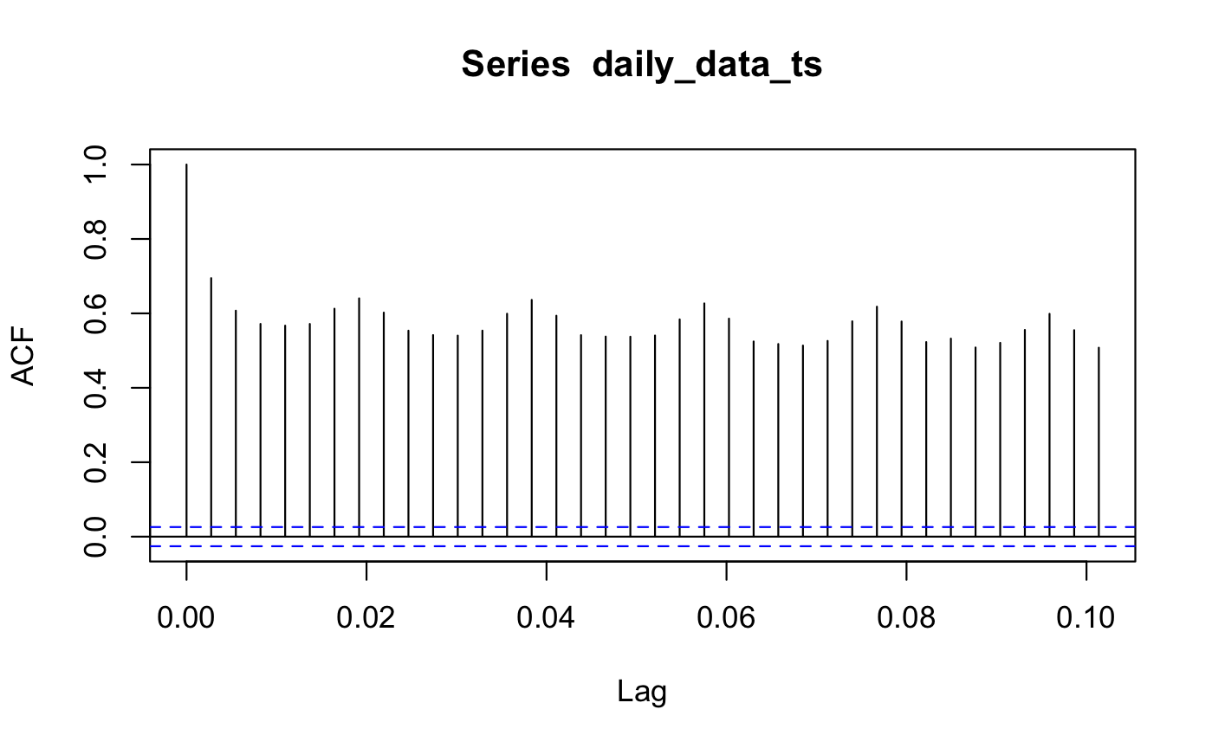
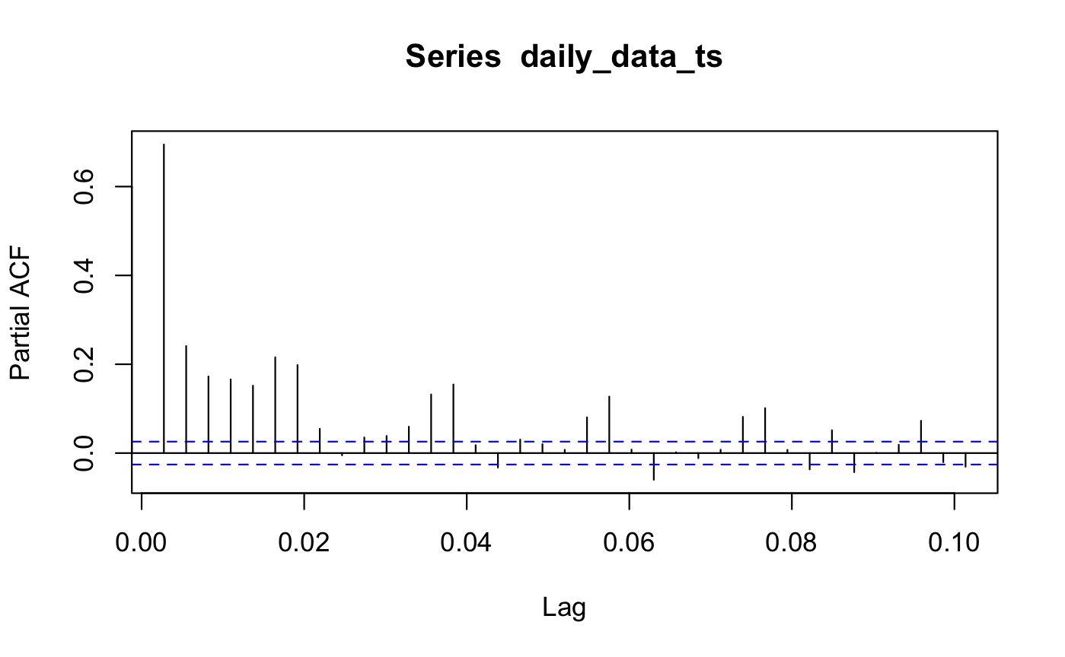
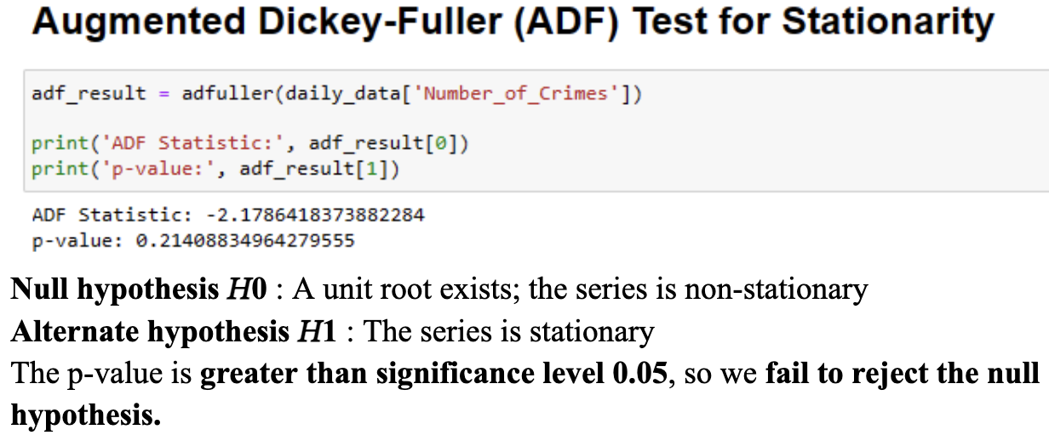

Slide 16
MODELING AND FORECASTING
With a 90% training, 10% testing split to predict the crime-rate in Downtown Chicago.

Slide 17
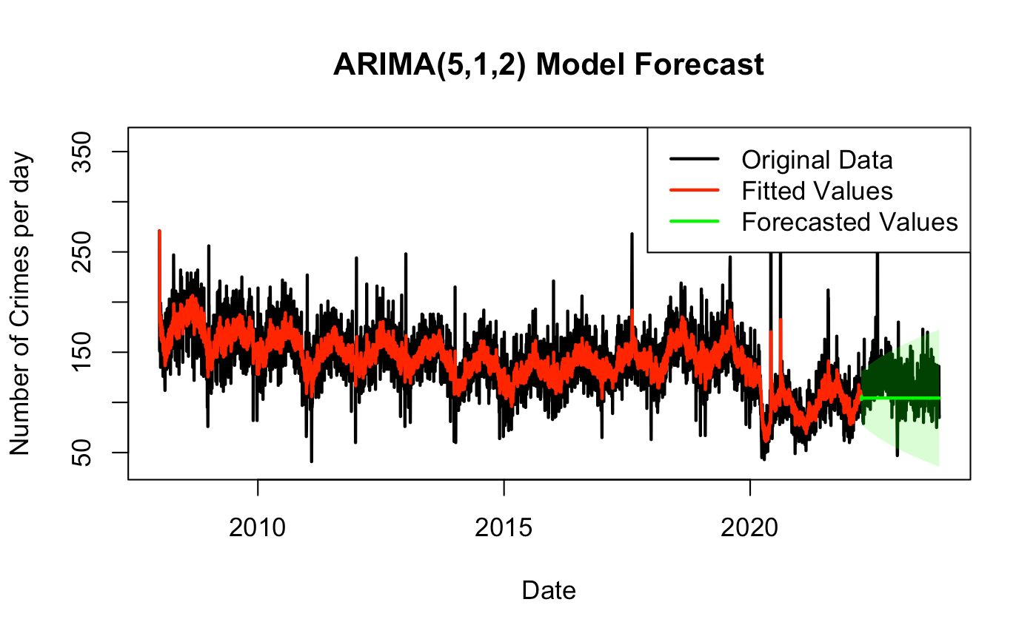
MAPE: 14.36%
RMSE: 24.43

Slide 18
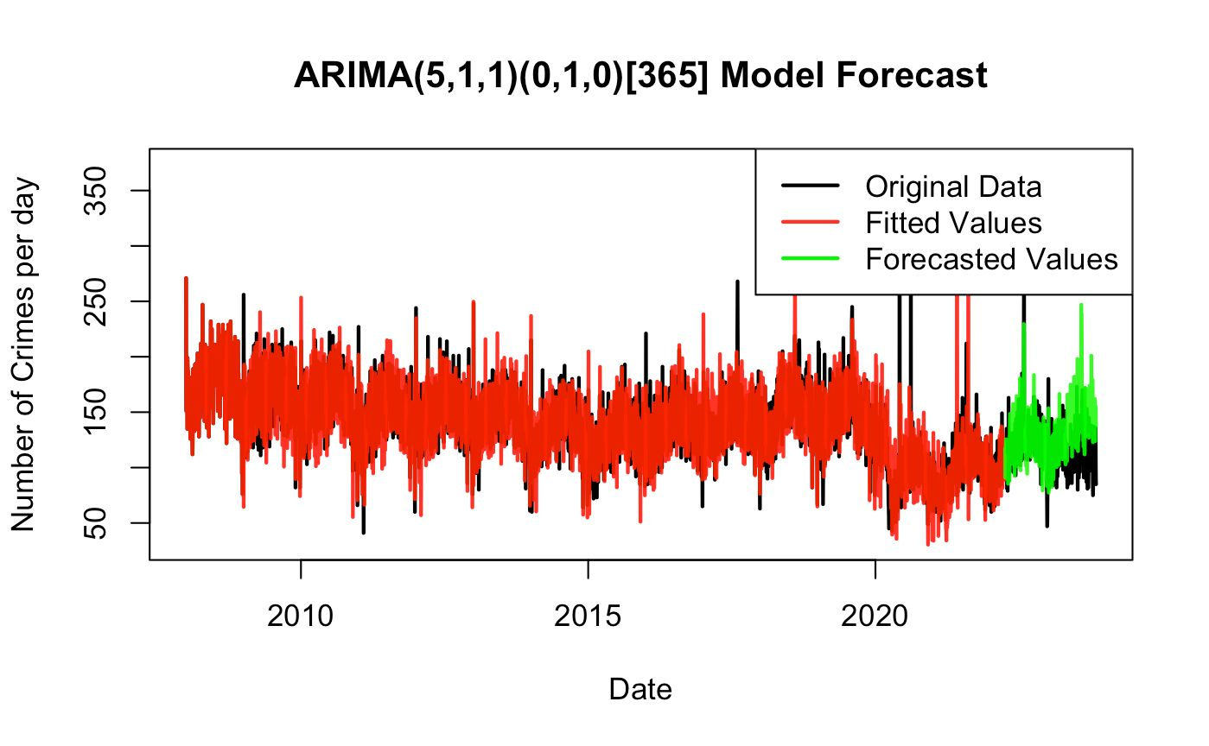
MAPE: 20.08%
RMSE: 29.30

Slide 19
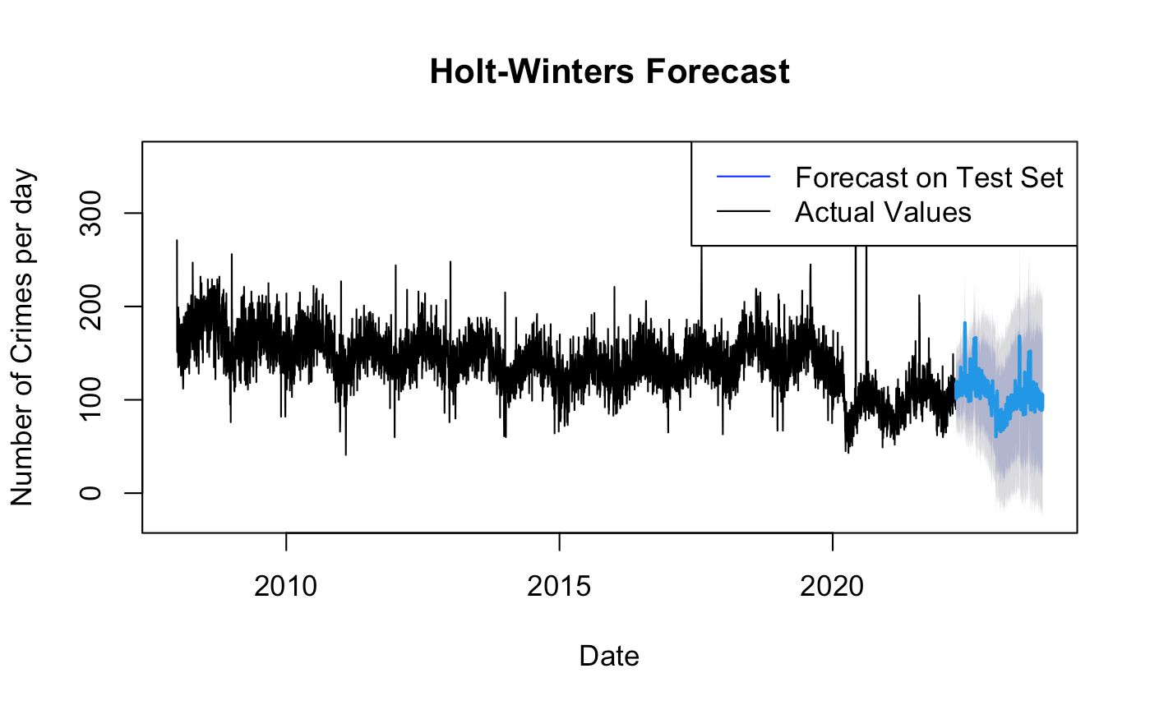
Triple exponential smoothing for level, trend, and seasonality
MAPE: 16.66%
RMSE: 26.68

Slide 20
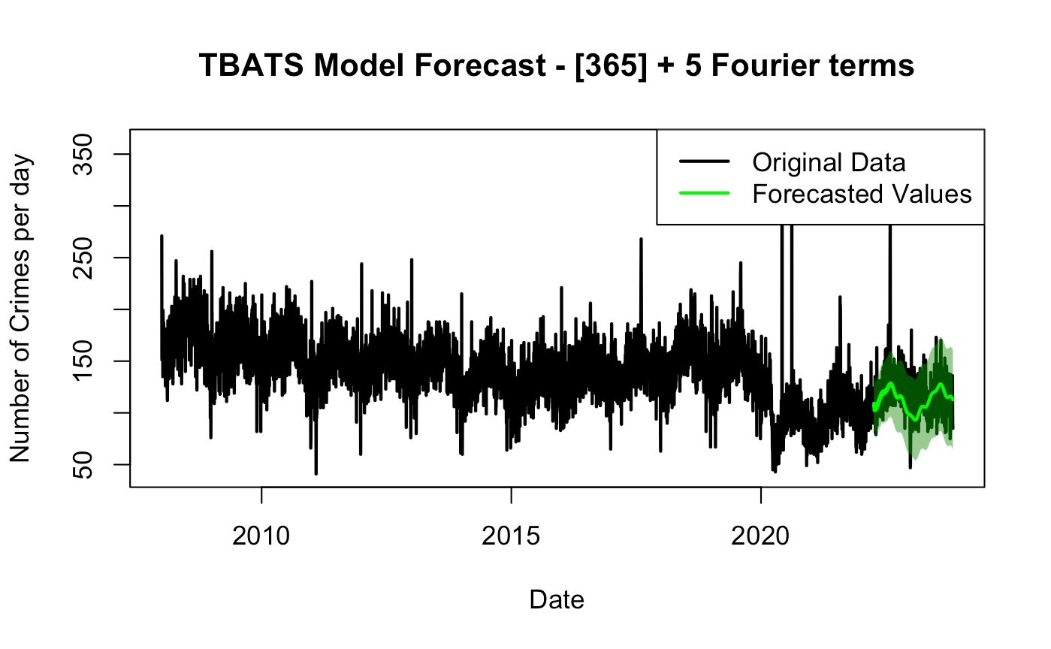
Trigonometric seasonality, Box-Cox transformation, ARMA errors, trend and seasonal components
MAPE: 12.53%
RMSE: 20.61

Slide 21
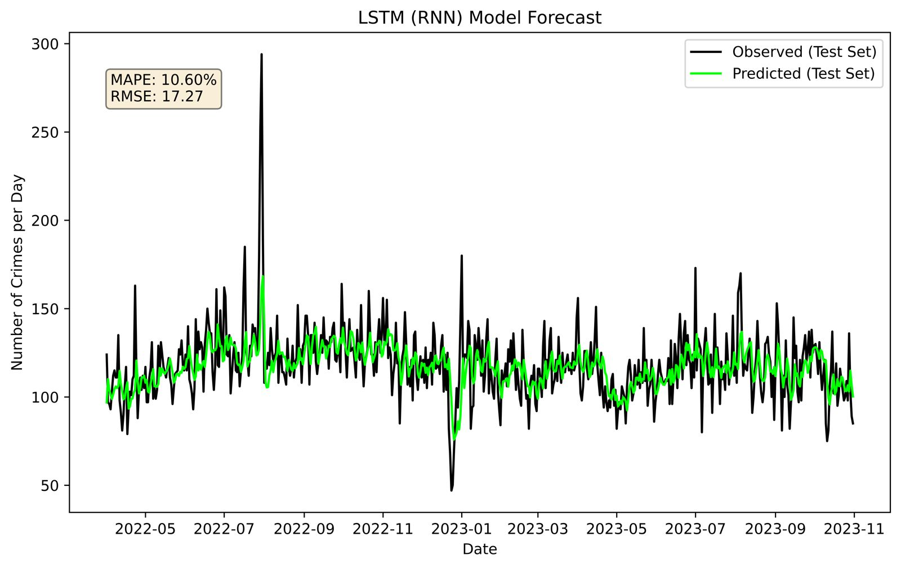

Slide 22
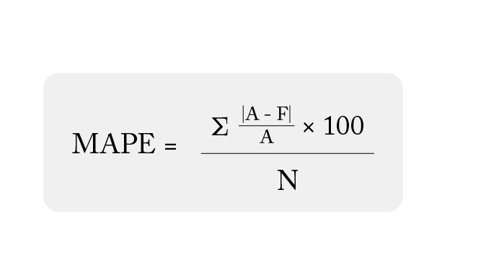
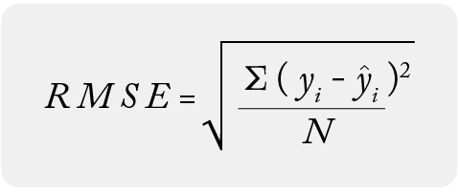
MODEL COMPARISONS
Mean Absolute Percentage Error
Model | MAPE | RMSE
ARIMA | 14.36% | 24.43
SARIMA | 20.08% | 29.30
Holt-Winters | 16.66% | 26.68
TBATS | 12.53% | 20.61
LSTM | 10.60% | 17.27
Root Mean Square Error

Slide 23
CONCLUSIONS AND FUTURE SCOPE
LSTM is the best performer
Models can help city officials and police departments allocate resources.
Take relevant action based on forecasts like more patrol cars in certain areas and Optimal timing of police checkpoints
Consider incorporating additional data sources, such as weather data, social media trends to enhance the model's predictive capabilities.
For future optimization
Increase complexity of LSTM
Increase granularity of models (ex. predict number of particular types of crimes)

Slide 24
Thank you !
Questions?

